Slide 1


Slide 2
TAVANA Background
2008 – 2015
Nanoclub manager
Workshops and seminars
Educational Exhibition
Nano Olympiad
Nano Festival
Educational Nanolab
2015 – Present
TAVANA Company CEO

Slide 3
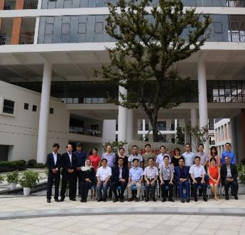
TAVANA Company
Name: Tose’e Ofogh Nano Fanavari Tavana
Date Of Stablishment: Dec. 2015
Corporate Vision:
Providing educational products and services in the field of high and knowledge-based technologies in and out of the country

Slide 4
TAVANA
Products
Workshop & Courses
  Basic STEAM Workshop (10-14)
  Advanced STEAM Workshop (15-18)
  Collage Workshop (collage & university)
  Professional Workshop (Researchers)
  Teacher Training workshop (school teachers)
  Simulation of Nano world
Learning Kits
  Expositive Kits
  Educational Kits
Nano Labs
  Advanced Nano Equipment, (Technician and Researchers)
  List of Laboratories
  Nano Park (Up to 6 years old), (games, show room, events center)
  Virtual Education Portal (courses, video, competitions, events, webinar)

Slide 5
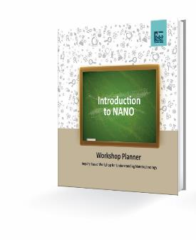
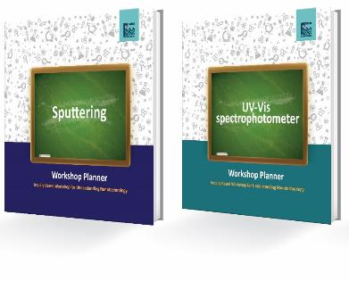
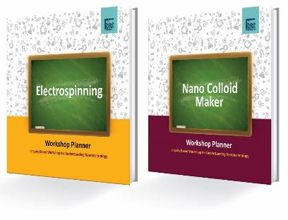
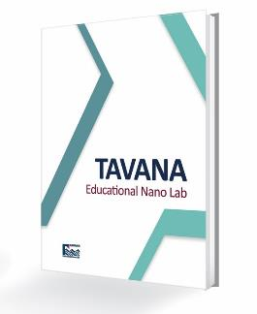
TAVANA
Products
  Basic STEAM Workshop (10-14)
Workshop & Courses
  Advanced STEAM Workshop (15-18)
  Collage Workshop (collage & university)

Slide 6
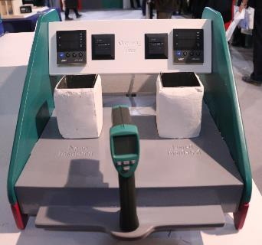
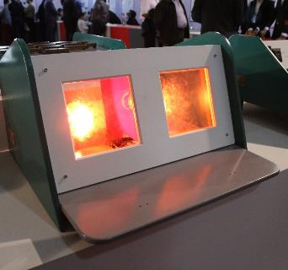
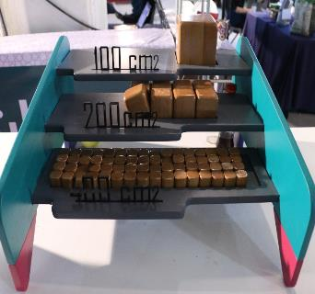
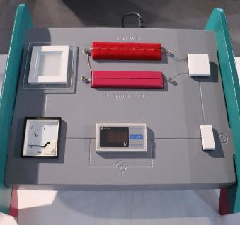
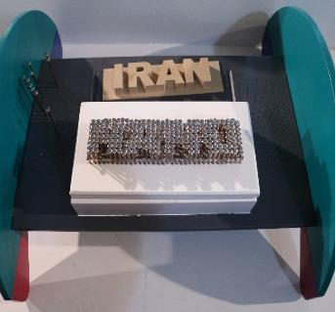
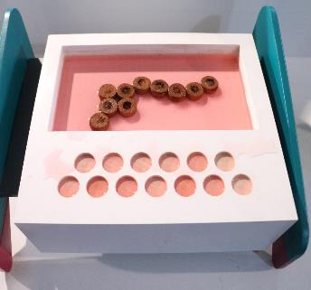
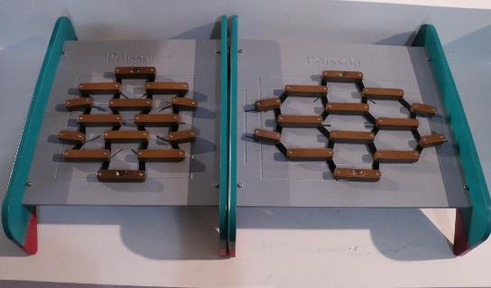
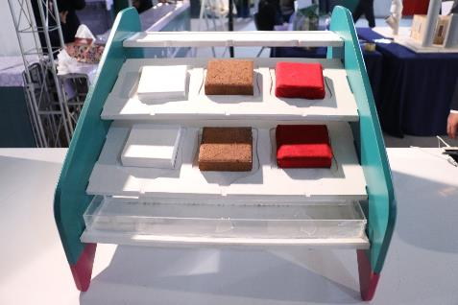
TAVANA
Products
Learning Kits
  Expositive Kits

Slide 7
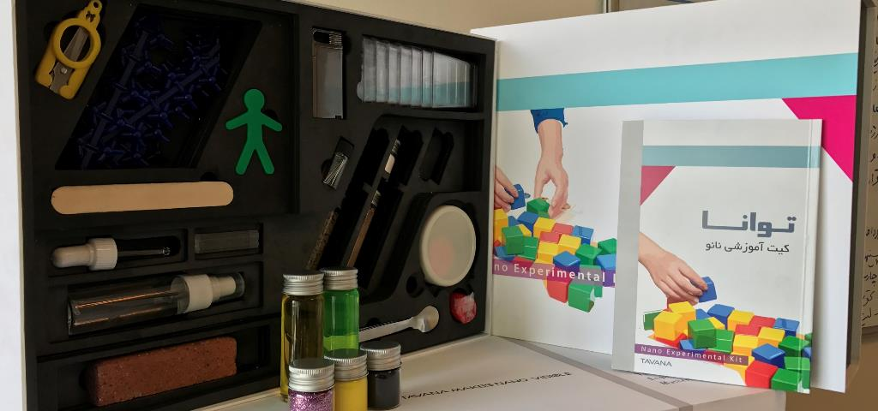
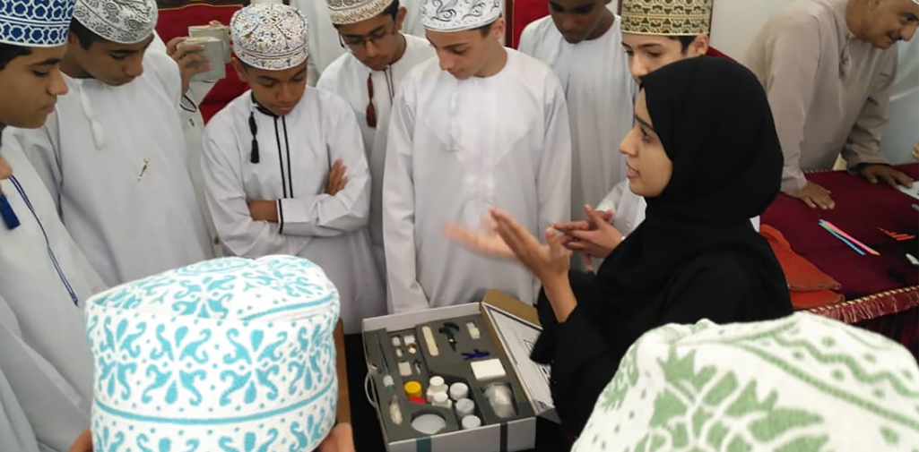
TAVANA
Products
Learning Kits
  Educational Kits

Slide 8
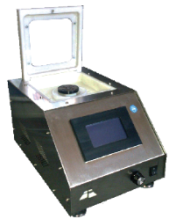
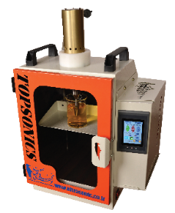
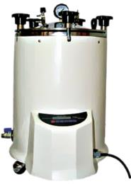
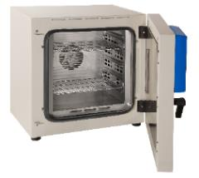
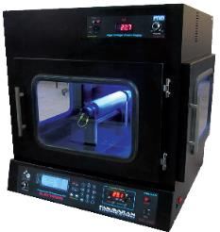
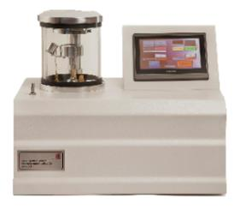
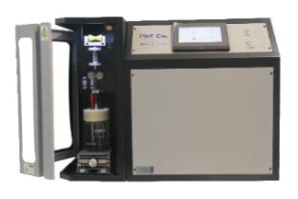
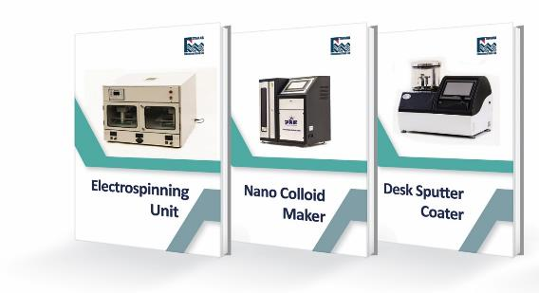
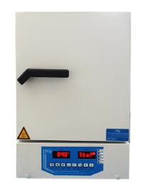



TAVANA
Products
  Advanced Nano Equipment, (Technician and Researchers)
Nano Labs

Slide 9
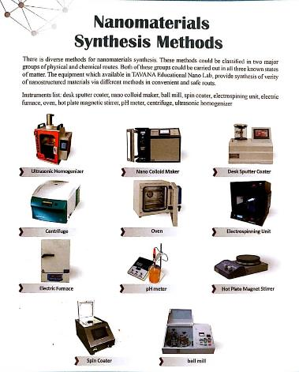
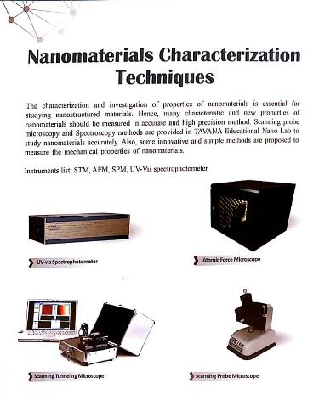
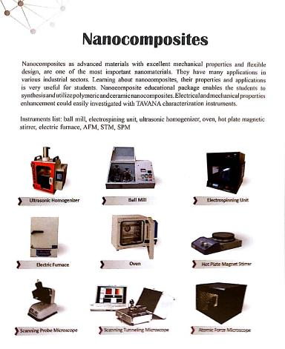
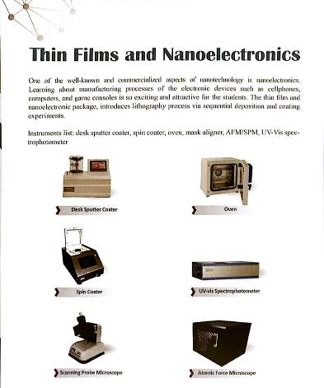
TAVANA
Products
Nano Labs
  List of some Laboratories

Slide 10
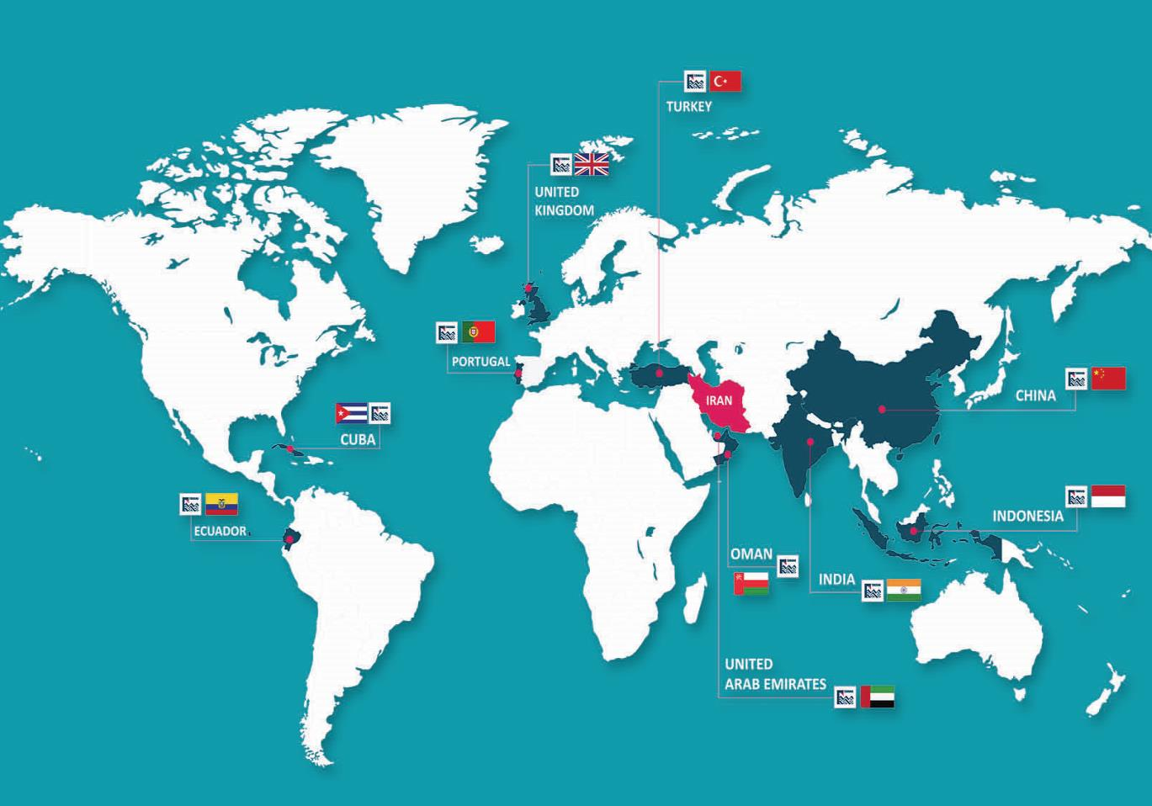
TAVANA Partners & Events

Slide 11
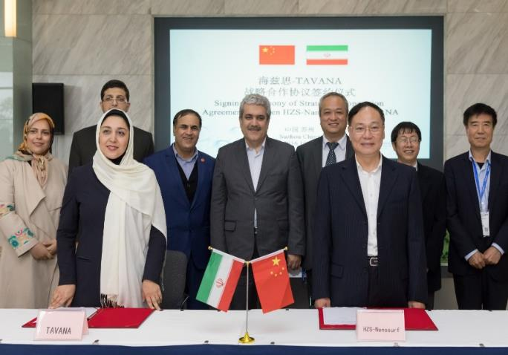
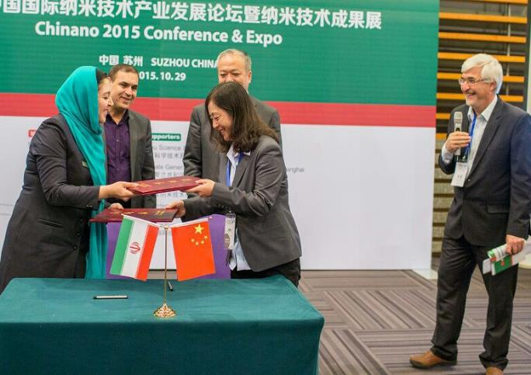
International Contract And MOU
HZS-Nanosurf- China
Jul/26/2016
Strategic Cooperation Agreement
United Industrial Services-UK
Oct/03/2016
TAVANA Agent
ULEAM Company-Ecuador
Oct/11/2017
MOU
Advanced Universal Tech LLC (AUT)- Oman
Sep/28/2018
Partnership Agreement

Slide 12
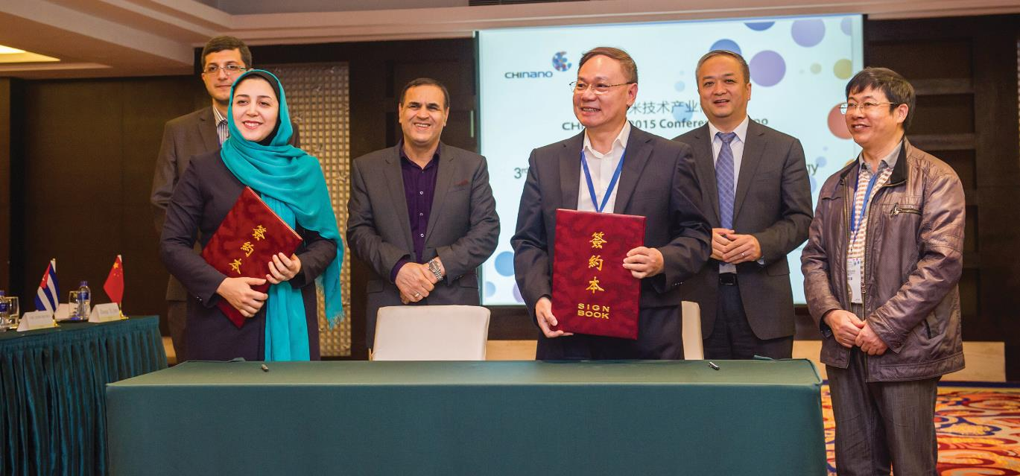

China
TAVANA international activities were started by signing a strategic cooperation contract with HZS-Nanosurf on Sep. 2015 to lunch nanotechnology laboratories for Chinese middle and high school students.

Slide 13
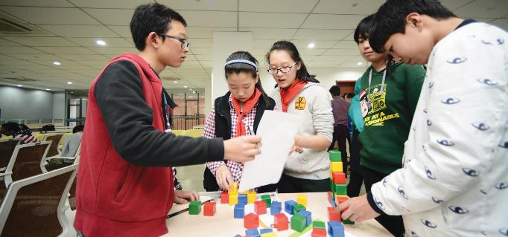
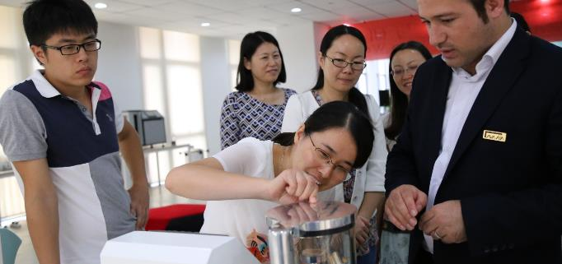
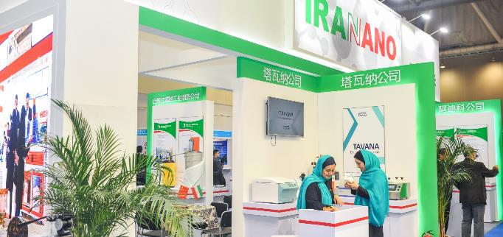
China
  • Holding nanotechnology STEAM workshops for students, 2016-2015
  • Holding teacher training workshops, Guangdong Provincial Party School Guangzhou, July 2017
  • Attending CHINANAO annual exhibition from 2015 up to now

Slide 14
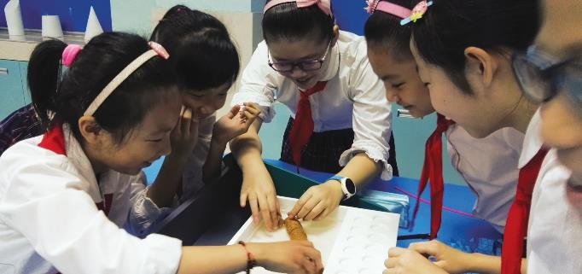
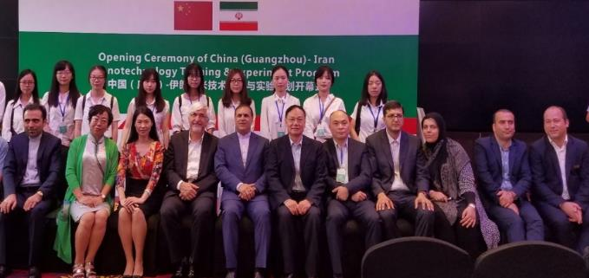
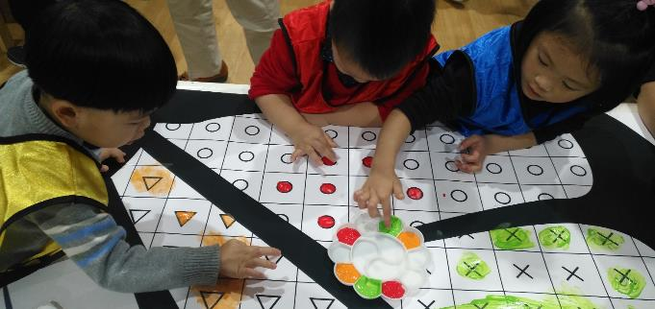
China
  • Participating in opening ceremony of TAVANA Nano Lab Guangdong Provincial Party School Guangzhou, July 2017
  • Attending CHENGDU educational exhibition May 2018
  • Attending Business Matchmaking, Shanghai, May 2018
  • Holding nanotechnology STEAM workshops for kids in GANSO Dreamworld, Oct. 2018

Slide 15
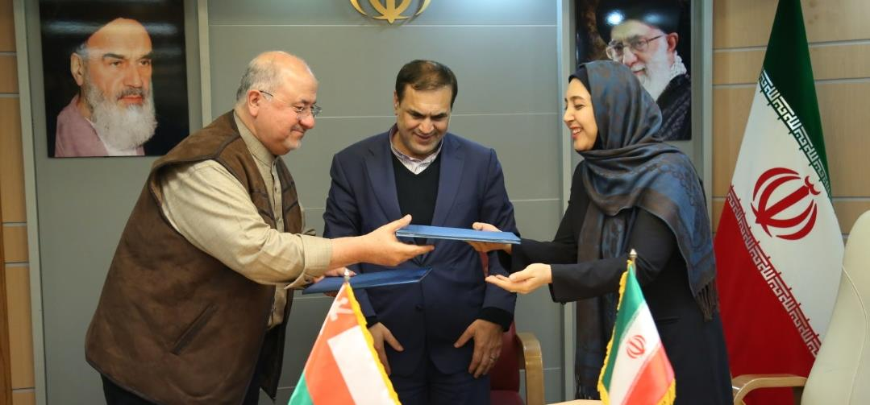

Oman
A cooperation contract between TAVANA and AUT Co. was signed for lunching an educational portal on Dec. 2018.

Slide 16
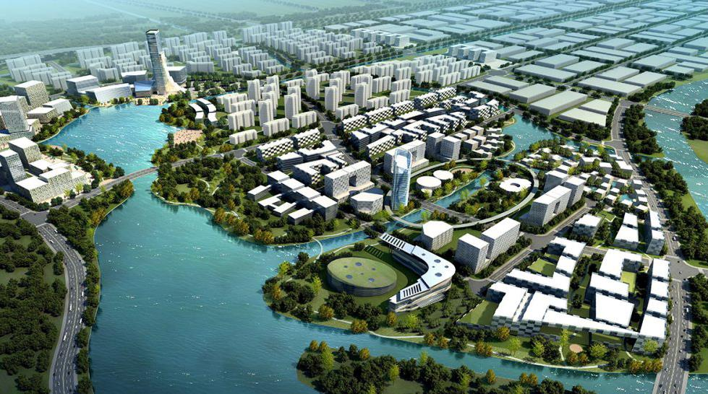

TAVANA
Current projects
Nano Park

Slide 17
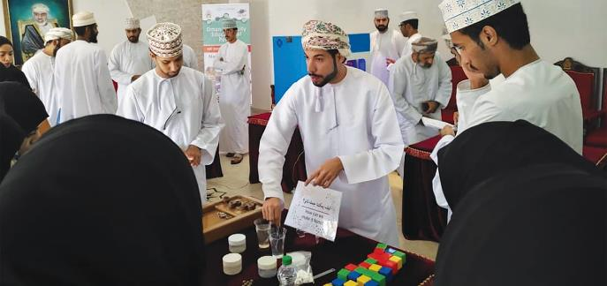
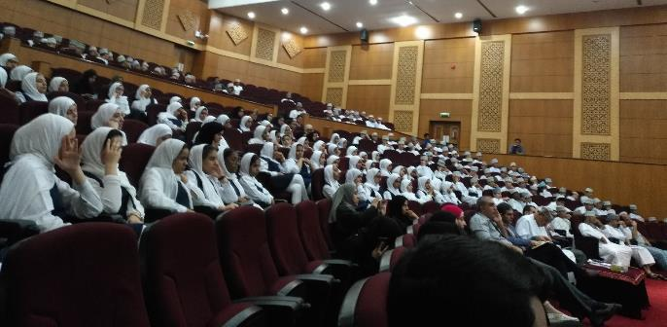
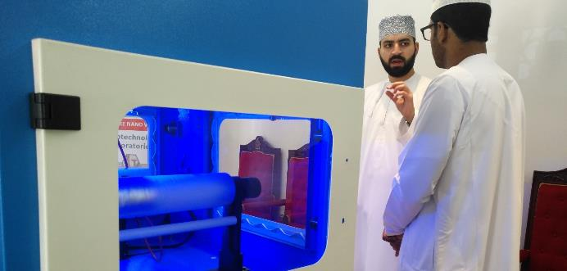
Oman
  • Holding a show room of Iranian Advanced Equipment for Omnia commercial board (Alfekr) in Tehran and Tabriz, Feb 2017
  • Holding nanotechnology STEAM workshops for school and college students, Muscat, Al Mussana, Nizwa, Sep. 2018

Slide 18
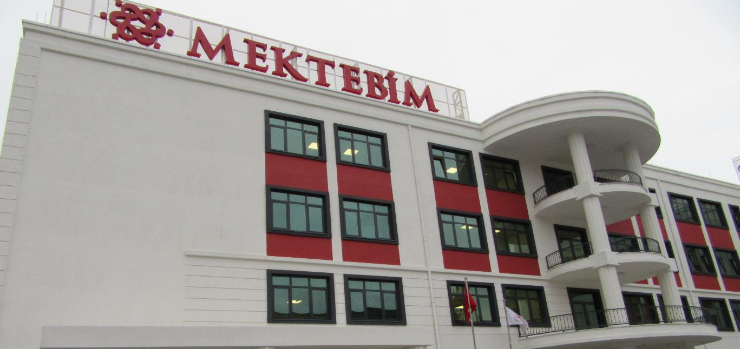

Turkey
Our activities in Turkey were started by Launching an agent office in Istanbul and it lead us towards holding some STEAM workshops in Gokksagi, Liceo and Mektebim colleges and schools.

Slide 19
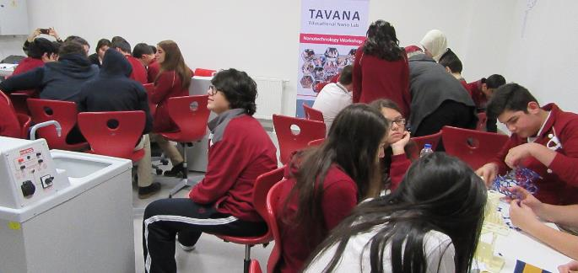
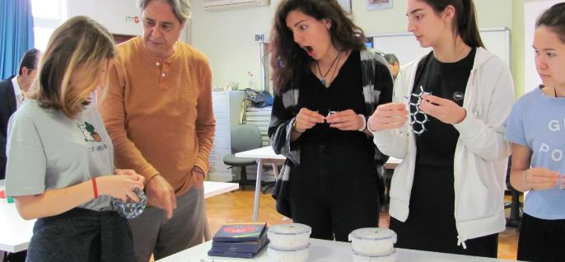
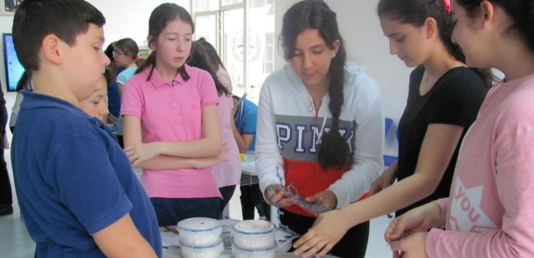
Turkey
  • TAVANA STEM workshop Gokksagi college Istanbul, June 2016
  • TAVANA STEAM workshop Liceo, Italian college Istanbul, Nov. 2016
  • Holding STEAM workshops for students (Mektebim school) Jan. 2017

Slide 20
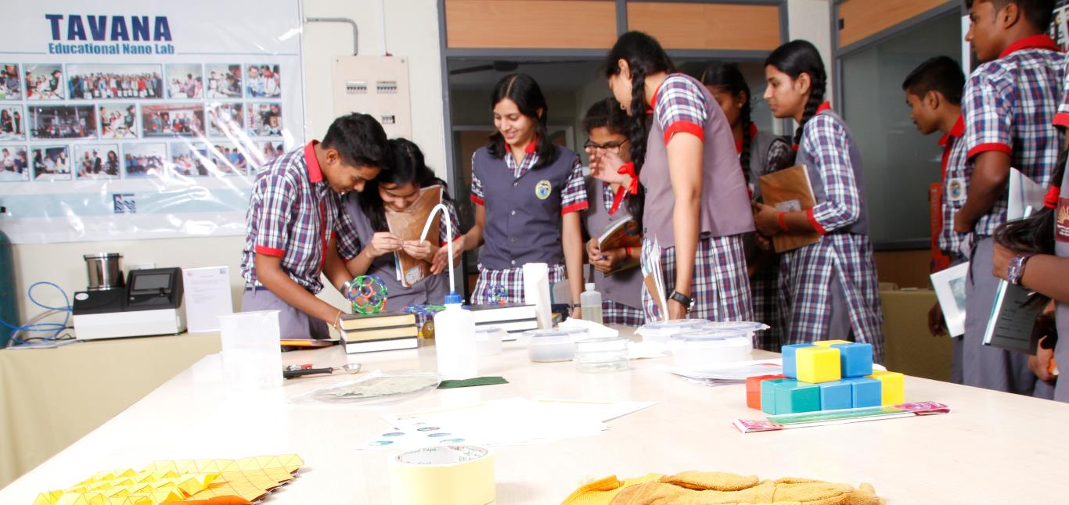

India
lunching a temporary show room of nano advanced equipment in Hyderabad on Oct 2016 was the result of signing MOU between TAVANA and Royal Life Science Indian Co. on 2015.

Slide 21
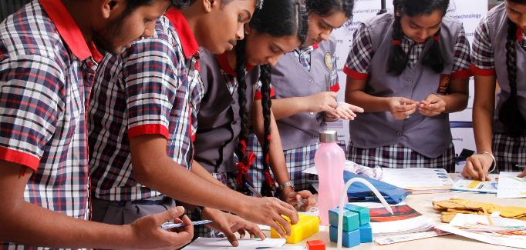
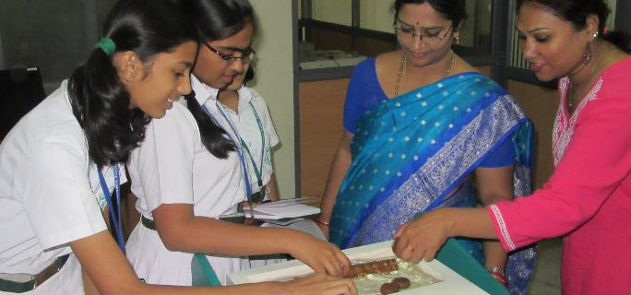

India
  • Attending INDIALABEXPO exhibition, 2016
  • Holding a show room of Iranian Advanced Equipment, Oct. -2016 May 2017
  • Holding four STEAM workshops for students, 2017 -2016

Slide 22


Ecuador
A cooperation contract between TAVANA and ULEAM Co. was signed to produce educational kits in Ecuador.

Slide 23



Ecuador
  • Holding STEAM workshops for students of Manta school, Dec. 2017
  • Holding workshops for university Students, Manta university, Dec. 2017

Slide 24


Cuba
A nanobiotechnology laboratory was lunched on Centro de Estudios Avanzados de Cuba (CEAC research center) in Havana.

Slide 25



Cuba
  • Launching a nanobiotechnology laboratory, Havana, Jan. 2018
  • Training the operators and technicians of CEAC research center, Feb. 2018

Slide 26


Indonesia
TAVANA participated in business match making on Sep 2017 to enter the new market in Southeast Asia.

Slide 27



Indonesia
  • Attending Indonesia GESS (Global Educational Supplies & Solutions) Exhibition, Jakarta, Sep 2016
  • Attending Business Matchmaking Jakarta, Sep 2017

Slide 28


United Kingdom
BETT is the first annual industry show of the year in education technology landscape, bringing together 850 leading companies, 103 exciting new EdTech startups and over 34,700 attendees from the global education community. TAVANA participated in BETT exhibition on 2018.

Slide 29


United
Arabic Emirates
GESS Dubai 2019 saw 12,000+ education professionals participate in over 250 CPD accredited seminars and workshops, learning from the very best in education in the pursuit of excellence in the classroom. TAVANA annually participates in this exhibition.

Slide 30


Portugal
EBN is a network of about 150 quality-certified EU|BICs (business and innovation centers) and 100 other organizations that supports the development and growth of innovative entrepreneurs, start- ups and SMEs. TAVANA participated in EBN conferences on 2015.

Slide 31




TAVANA
Current projects
Nano Park

Slide 32



GANSO
元祖
Ganso Dream Dessert
Ganso Initiate park
Exquisite gift
National Science Education Base
元祖梦世界
Ganso Dream world
The third space for children's recreation

Slide 33

Ganso Dream Dessert
37
Gnaso always insist on
Exquisite gift
y
  Leading enterprise in China's bakery food industry
  More than 600 offline stores nationwide
  well-known Chinese brand
  A-share in Shanghai Stock Exchange
  stock code：603886
Premium product production and channel management

Slide 34


Ganso Initiate park
  National Science Education Base
  Founded in 2004, The first science education base nationwide with the theme of cake DIY food safety
  Area：3000㎡
  Average daily reception：300-700 groups
  Annual reception：no less than100,000 persons
  Since 2004，total reception about 2.5 million children and families
Ganso Dream World
Origin & laboratory

Slide 35



Ganso Initiate park
  Fully focus on children aged 3-10
  Social education practice base
  Established the Children's Social Education Research Institute to explore the origin of education Committed to becoming the children social education practice base outside the home and school
元祖梦世界

Slide 36


Dream World architect
In 2013，Tadao Ando joined hands with Ganso Dream World
Architectural design
安藤忠雄
TADAO ANDO
Dream World architect
Pritzker Architecture Prize winner World-famous architect

Slide 37


Region: Radiate Yangtze River Delta
  Nonstop arrival for 26 cities agglomeration from Jiangsu, Zhejiang, Shanghai and Anhui 20 million children aged 3-10 year in the Yangtze River Delta
  2-hour city circle, 3.2 million 3-10- year- old children's family
Radius | Child aged 3-10 | Driving | linked cities
50KM | 20万 | 0.5h | 昆山/嘉善
100KM | 80万 | 1h | 苏州/无锡/嘉兴
200KM | 320万 | 2h | 杭州/常州/湖州

Slide 38

Surroundings
High scale community
5000 villas with 5 kms
International School, Kindergartens 14 International School, Kindergartens
30 minutes driving time
Cover 3 million population ,
60000 children aged 3-10
Abundant tourism resources
Abundant scenic spots and hotels
Shi xi software park
Enterprises: Huawei R & D Center, Tencent, Caohejing
Scale: 2 million m2 in 2020
Population：80,000 in 2020
Production value: 60 billion in 2020

Slide 39

Social Hub
儿童社交中心
Total area: 55,000㎡
Focus on 160 brands, offer 300 sets of courseware A platform of brand promotion and social experience for children Offer all-round experience and broad social space Three types of space formats
5 large theme venue
2 experiential theme area Kids Expo

Slide 40



Type1 Theme venue:
Large-scale, high-capacity anchor store
1
Children Cinema
Theme of education
2
Children Theatre
Theme of children's performance and art training
3
Expedition pavilion
of the south pole
Theme of ice and snow
scientific education

Slide 41




Type1 Theme venue:
Large-scale, high-capacity anchor store
4
Children's science museum
The world-famous children's science expo
5
L·L·DO
Children's art and culture park

Slide 42




Type2 experiential theme area:
Revolutionize traditional formats
Children’s cuisine
Educational innovation cuisine of food culture combined with global cuisine
Children’s new retail
Theme of children's garment design and aesthetics

Slide 43

Owl College
猫头鹰学院
Total area：36,000㎡
Children education learning platform comprised of 50 educational brand Offer specialized, all-round educational environment
Three types of space formats
2 theme store
1 theme area
4 departments

Slide 44


Owl College
猫头鹰学院
  Theme store（1）
  Montessori Plus Kindergarten
  Introduce the Harvard Zero Program Montessori International Kindergarten certified by the American AMS

Slide 45


Owl College
猫头鹰学院
  Theme store（2）
  Life research institute
  Theme of children's clinic and
  preventive health care

Slide 46


Owl College
猫头鹰学院
  Theme area（3）
  Children health care center
  Children supermarket
Located at B1，total area 2000㎡；
Theme of children’s financial education and food material science
Children can earn and spend Dream coins by experiencing small-store managers, supermarket employees, and popular science activities, as well as learning knowledge about food material science:

Slide 47
Introduction of group guest
flow from Monday to Friday
Sweet factory with 14 years operation has accumulated abundant channels and access resources for the dream world.
Focus on solving the problem of shortage of passenger flow From Monday to Friday.
Access to nearly 1,000 kindergartens and primary schools in Shanghai
Access to 300 stores along Yangtze River Delta
The daily reception is expected to have 3000 families.
60%
Group guests
40%
Individual
guests
Visitors in Dream World :
Group guests account for 60%

Slide 48

200
Dream World has
merchants
300
Offer children
courseware experience
9
150000
㎡
cover
Children industry，
total area

Slide 49

فضای اختصاص داده شده به مجموعه توانا

Slide 50
Path
This path demonstrates the education scenario which determines the pattern of the way of the audiences. The design of reception and waiting areas, and the ease in which people are able to move independently around a booth, have a similar influence on overall accessibility. The well-designed layout with clear access routes and doors that are sufficiently wide and easy to operate demonstrates a commitment to universal design throughout.

Slide 51


Zones Arrangement
The Zones contain all of the fundamental concepts and the applications of Nanotechnology:
How small is Nano?
What is Nano?
Is Nano different?
Make Nano visible?
You and Nano?
So, what?
About Nano
Scale
Properties
Instruments
Memorial
Application

Slide 52


Drug Delivery
This game has been designed to familiarize children with the drug delivery mechanism which is one of the main application of nanotechnology in the medicine.
This game is simulating the process of drug delivery. So, the boxes, viruses and balloons respectively are symbols of body’s cells, disease and nano drugs. Firstly, the kids separated to some groups and they choose a balloon which is similar to their group color. Then they try to find the similar viruses from inside of the boxes. Finally, they stick the balloons to the viruses and release them from the boxes. This activity is done for each of group members. The winner is the group who can release all similar viruses.
As a result, by the end of this game, this procedure in the human body will show to kids in video clip and their teachers describe this phenomenon in the real world.
Zone:
What is Nano?

Slide 53


Self Arrangement
In this game, the kids stand up in front of the light to form the shadows. Then their mothers draw a line around of the shadows. For the next step, the kids and mothers change their position and the kids draw a line around their mother’s shadow. By the end of this activity, the children paint the shadows and a picture is taken from shadows with the kids and mothers as a gift.
By this game, the process of TEM microscope is learnt to the kids.
Zone:
Make Nano visible!

Slide 54


TEM
In this game, a group of children wear boxes and try to occupy the smallest space in the area which is marked by the line at the floor of the hall. A broadband is used by one parent or coach to check the occupied space by the kids. After several times when children are not able to stand in the specific area, the coach help them to form in the correct position and layout of the pieces.
By this game, the kids become familiar with the different synthesis approach in the nanoworld.
Zone:
Make Nano visible!

Slide 55


Scale
Initially, one of the puzzles is selected and put on the ground. Then the kids search on the puzzle by the big magnifier to find the next puzzle picture or symbol which has been scaled down. When they can find the next puzzle symbol, the children try to find the related puzzle. This procedure will continue to complete the big puzzle.
By this game, the concept of the scale is learnt to the kids.
Zone:
Make Nano visible!

Slide 56

How can we attract and return back the audiences to the Nano Park?
Mobile App
A mobile app will designed with the attractive and interactive games to be keep in touch with kids
Holiday Workshops
Some amazing and educational workshops could hold in the holidays to return back the interested children.
Events
Seasonal and annual events with different type of subjects and competitions in the field of nanotechnology, could gather the participants.

Slide 57




Slide 58

TAVANA
+98 21 77 38 8060
+98 182 0621 2392
info@tavanalab.ir
www.tavanalab.ir

